Slide 1
AFDF: Anti-Forensic Detection Framework
INDIRA GANDHI DELHI TECHNICAL UNIVERSITY FOR WOMEN
An AI-Powered Web-Based Digital Forensics Tool for Detecting Evidence Tampering and Hidden Volumes
Presented by TRAILBLAZERS

Slide 2
Problem Statement
Key Issues:
Hidden Volumes: Encrypted partitions that blend into "random" disk noise.
Data Wiping: Intentional overwriting (Zero/FF/Random) to prevent recovery.
Evidence Tampering: Modification of file headers or metadata to mislead investigators.

Slide 3
Project Overview
AFDF is a web-based forensic engine designed to analyze disk images for hidden data and wipe patterns.
Core Pillars:
Statistical Analysis: Deep entropy and frequency scanning.
Machine Learning: Automated classification of disk regions.
Tool Integration: Leveraging industry-standard engines like The Sleuth Kit.
Target Users: Law Enforcement (LEAs), Corporate Incident Response (IR), and Security Auditors.

Slide 4
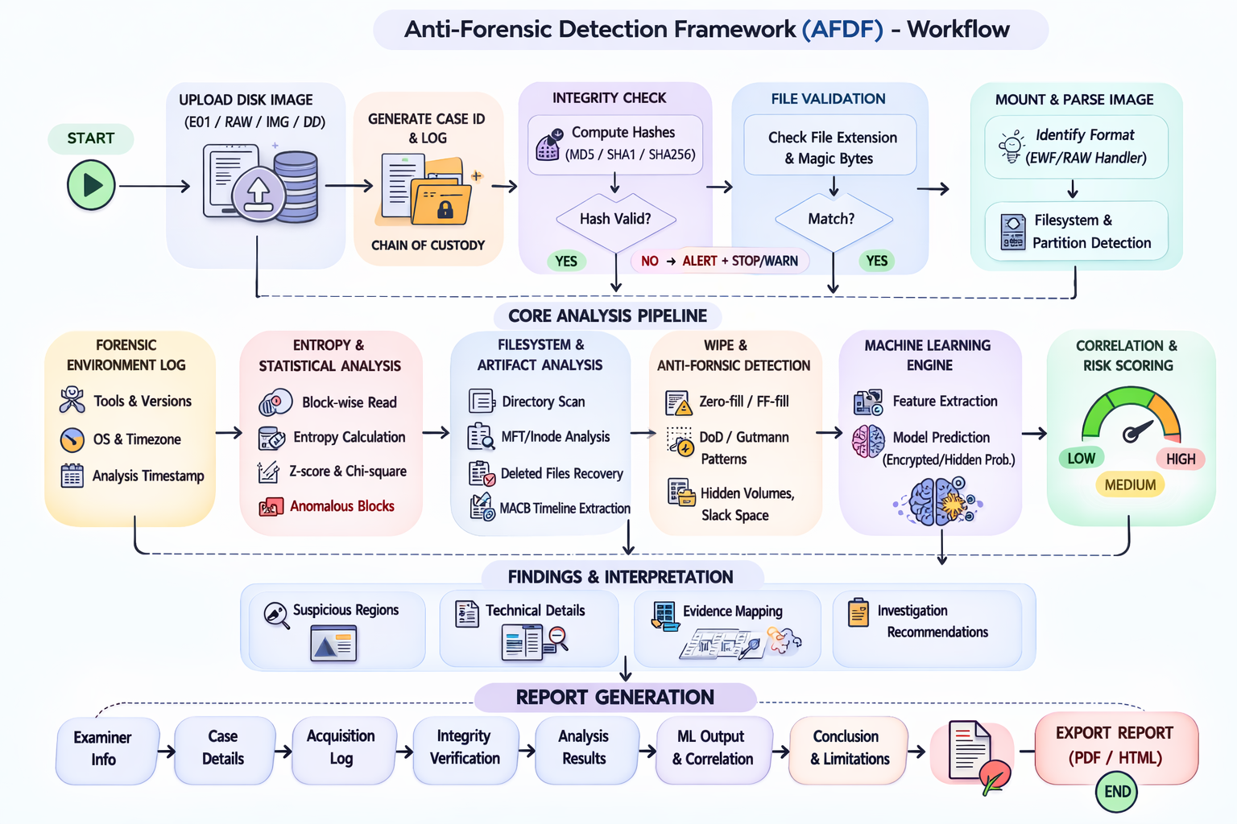

Slide 5
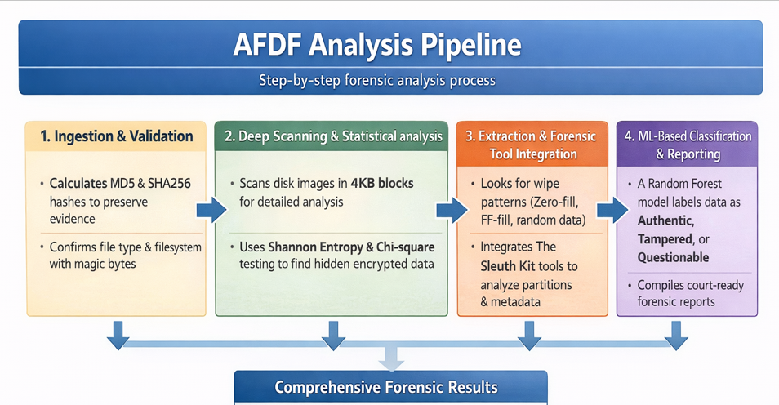

Slide 6
Deep Dive: Entropy & Wipe Detection
Entropy Analysis: Shannon entropy measures data randomness on a 0–8 scale to identify hidden encrypted volumes.
Data Indicators: High entropy (7.5–8.0) suggests encryption or compression, while low entropy (0–2) indicates zeros or padding.
Wipe Recognition: Automatically detects Zero-fill (0x00), FF-fill (0xFF), and Random-wipe patterns (Entropy > 7.6) in unallocated space.

Slide 7
Machine Learning & Forensics Integration
The Model: Utilizes a Random Forest Classifier to analyze features like Chi-square values, byte frequency, and null-byte ratios.
Classification: Automatically flags disk regions as Authentic, Tampered, or Questionable with a confidence score.
Tooling: Integrates industry-standard tools from The Sleuth Kit (mmls, fsstat, fls, blkls) for metadata and partition mapping.
Artifacts: Automatically extracts emails, URLs, IP addresses, and deleted file entries using bulk_extractor.
Standards: Identifies traces of professional sanitization like DoD 5220.22-M and Gutmann.

Slide 8
INVESTIGATOR FRIENDLY REPORT
16-Section Report: Generates a comprehensive forensic document including Examiner Info, Chain of Custody, and Evidence Integrity.
Legal Readiness: Includes a formal Examiner Declaration and detailed Timeline Reconstruction.
Supported Images: Compatible with Raw bit-streams (.dd, .raw), EnCase (.E01), and Logical images (.img).
Integrity First: Every report includes MD5 and SHA256 hashes to prove the evidence remained untampered during analysis.

Slide 9
Conclusion & Future Outlook
Summary: AFDF provides a "medical scanner" for hard drives, automating the detection of sophisticated anti-forensic techniques.
Key Value: Reduces manual hex-editing time and uncovers hidden data that traditional tools might miss.
Considerations: While powerful, performance depends on hardware and may face limitations with full-disk hardware encryption.
Next Steps: Continuous ML model training to adapt to emerging encryption and wiping methods.

Slide 10
THANK YOU
Q/A

